Slide 1
Oslo 14 December 2019

Slide 2
Introduction to ML.NET
Oslo
Vadim Frolov
Data Scientist @ Inmeta/Crayon

Slide 3
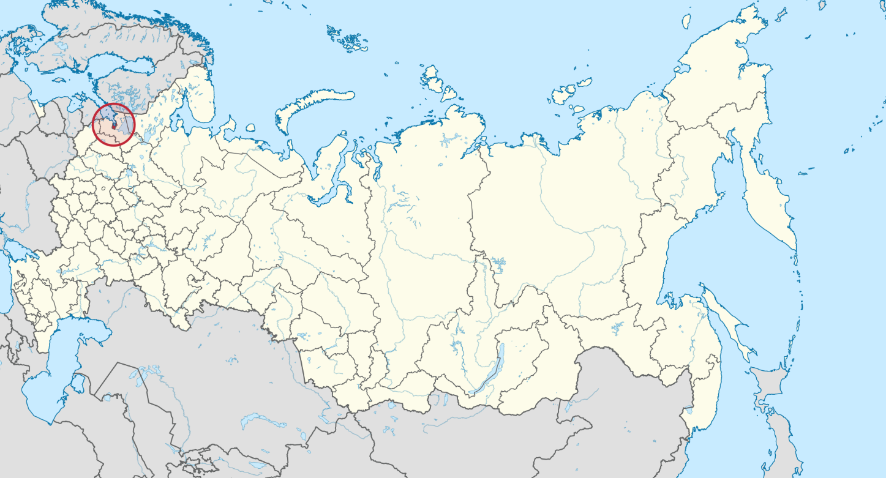
About me
Saint-Petersburg
Graduated in Russia in 2007 (MSc, Information Technology).
2008 – 2010 worked in Germany. Pedestrian recognition in scope of autonomous vehicles.
2013 – 2018 worked at NTNU in Moser lab. Analysis software for neuroscientists.
2018 -> Inmeta/Crayon. Consultant within machine learning area.

Slide 5











Slide 6
Introduction to machine learning

Slide 7

Machine Learning “Programming the UnProgrammable”
{
{
Is this a face?
Price of Shirt?
f(x)
f(x)
“It has exquisite buttons … with long sleeves …works for casual as well as business settings”

Slide 8



Machine Learning “Programming the UnProgrammable”
{
Machine Learning creates a
Face
Face
f(x) Model
Not a face
Not a face
using this data
Notes:
A model is an intelligent function which can predict

Slide 9
ML.NET

Slide 10



Languages for machine learning
Existing applications in C#
.NET developers
Platform for production

Slide 11














Your platform for building anything
DESKTOP
WEB
CLOUD
MOBILE
GAMING
IoT
ML
.NET

Slide 12

ANNOUNCED @ Build2019
ML.NET 1.0 @Build 2019
ML.NET
Machine Learning framework for building custom ML Models Custom ML made easy Automated ML and Tools (Model Builder and CLI) Proven at scale Azure, Office, Windows
Extensible TensorFlow, ONNX and Infer.NET Cross-platform and open-source Runs everywhere

Slide 13


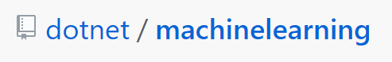
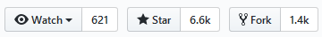
150K+
Downloads
ML.NET Open Source Momentum
1,979
Commits
2,117
Pull requests
106+
Contributors

Slide 14
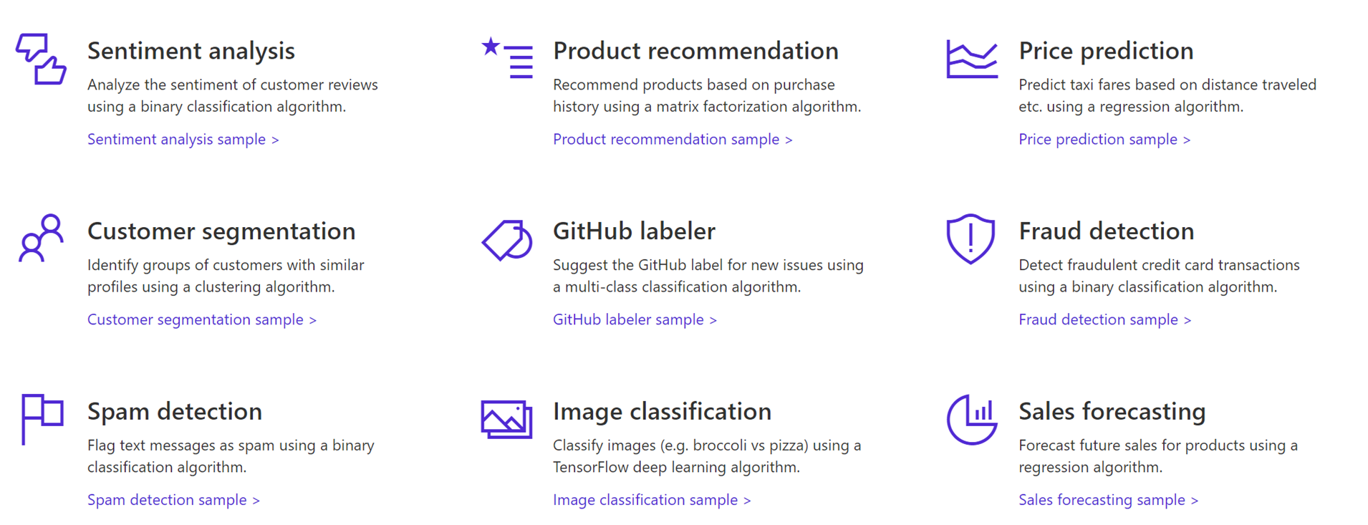

A few things you can do with ML.NET

Slide 15
https://dotnet.microsoft.com/apps/data/spark

Slide 16
Jupyter Notebook C#

Slide 17
ML.NET Key Concepts

Slide 18
1. Data
Data
Example
Comment Text | Sentiment
Wow... Loved this place. | 1
Crust is not good. | 0
Not tasty and the texture was just nasty. | 0
The selection on the menu was great. | 1
Notes:
Dataset: https://github.com/dotnet/machinelearning/blob/master/test/data/wikipedia-detox-250-line-data.tsv

Slide 19
2. Transformers
Data
Data
Transformer
Data
Example
Text
Wow... Loved this place.
Crust is not good.
Not tasty and the texture was just nasty.
The selection on the menu was great.
Featurized Text
[0.76, 0.65, 0.44, …]
[0.98, 0.43, 0.54, …]
[0.35, 0.73, 0.46, …]
[0.39, 0, 0.75, …]
Text Featurizer
Notes:
Transformers take data, do some work on it, and return new transformed data.
One example of a transformer we will need in our example is a Text Featurizer, which takes the text in the issue text and converts it to numbers that our ML algorithms can understand.

Slide 20
3. Estimators
Data
Data
Transformer
Data
Data
Estimator
Transformer
Example
Comment | Sentiment
Wow... Loved this place. | 1
Crust is not good. | 0
Not tasty and the texture was just nasty. | 0
The selection on the menu was great. | 0
Estimator
Model (Transformer)
Notes:
An estimator learns from data to create a transformer. Now a model, which turns the input features into output predictions, is a transformer. So we can take estimators that take our example data and produce a model.

Slide 21
Sentiment Analysis
Comment | Toxic? (Sentiment)
==RUDE== Dude, you are rude … | 1
== OK! == IM GOING TO VANDALIZE … | 1
I also found use of the word "humanists” confusing … | 0
Oooooh thank you Mr. DietLime … | 0
Features (input)
Label (output)
Wikipdia detox data at https://figshare.com/articles/Wikipedia_Talk_Labels_Personal_Attacks/4054689

Slide 22
Sentiment analysis live demo
Let’s try it out at https://blazorsentimentanalysisproduction.azurewebsites.net/

Slide 23



Try ML.NET today!
Get started at http://dot.net/ml
Try samples at http://aka.ms/mlnetsamples
Read the docs at http://aka.ms/mlnetdocs
Submit issues or contribute http://aka.ms/mlnet

Slide 25
Any Questions?

Slide 26
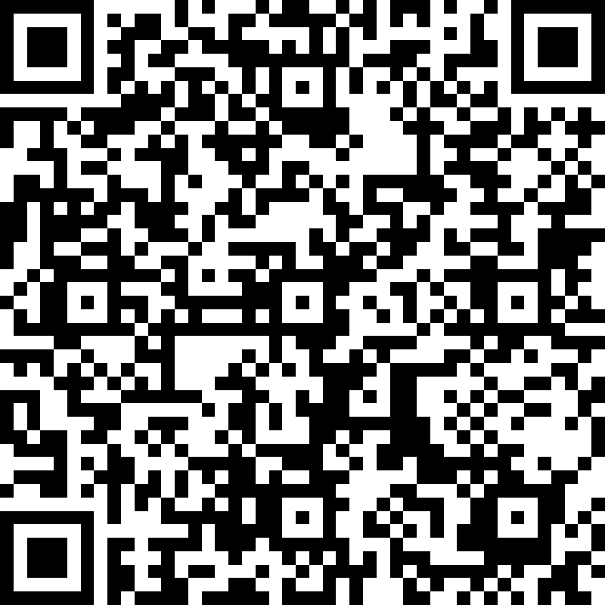
Introduction to ML.NET
Vadim Frolov
vadim.frolov@inmeta.no
https://github.com/fralik
https://www.linkedin.com/in/vadimfrolov/

